Slide 1
Recommendation Systems in R

Slide 2
Agenda
What are Recommendation Systems?
Content-based Filtering
Collaborative Filtering
What is Matrix Factorization ?
What is Singular Value Decomposition ?
Examples

Slide 3
RoadMap
Introduction
What are recommendation engines?
How does a recommendation engine work?
Data collection
Data storage
Filtering the data
Content Based Filtering
Collaborative Filtering
Collaborative Filtering with User-User Method
Collaborative Filtering with Item-Item Method
Matrix Factorization
Singular value decomposition
Alternating Least Squares
© 2023 AiProff.ai

Slide 4
What are Recommendation Engines?
Until recently, individuals typically preferred purchasing items suggested by their friends or those they trust.
This was the go-to approach for making a purchase, especially when uncertainties about a product existed.
However, in this digital era, the landscape has evolved to encompass online platforms employing recommendation engines.
It is the conscious and unconscious choices that we make, become a potential indicator of what would be our next choice
These engines sift through data employing various algorithms to suggest the most pertinent items to users. They begin by analyzing a customer's previous behavior and, using that information, propose products that align with the user's potential preferences for purchase.
© 2023 AiProff.ai

Slide 5
What are Recommendation Engines?
When a completely new user explores an e-commerce site, the site lacks any prior history of that user.
So, how does the site approach in suggesting products in such a situation? One potential solution involves recommending the best-selling products, those in high demand.
Alternatively, the site might suggest products that would generate maximum profit for the business.
By offering tailored recommendations based on a customer's needs and interests, a positive impact on user experience is achieved, fostering repeated visits.
Consequently, contemporary businesses are investing in the development of intelligent recommendation engines, leveraging insights from the past behavior of their users.
Now that we've gained an understanding of recommendation engines, let's delve into how they operate.
© 2023 AiProff.ai

Slide 6
How does a recommendation engine work?
Before delving into the intricacies of this topic, let's explore some plain vanilla approaches for recommending items to users:
Recommending items based on overall popularity among all users.
2. Segmenting users based on their preferences (user features) and tailoring recommendations according to the segment they belong to.
Both methods have their drawbacks. In the first case, everyone sees the same recommendations as the most popular items remain constant for all users. In the second case, with an increasing number of users, handling a growing number of features becomes a challenging task.
The core issue here is the inability to customize recommendations according to individual user interests.
It's akin to Amazon suggesting a laptop solely because it's a popular choice among the majority of shoppers.
Companies like Amazon don't rely on such approaches. Instead, they employ personalized methods that enhance the accuracy of product recommendations.
So how do we improve on this ?
© 2023 AiProff.ai

Slide 7
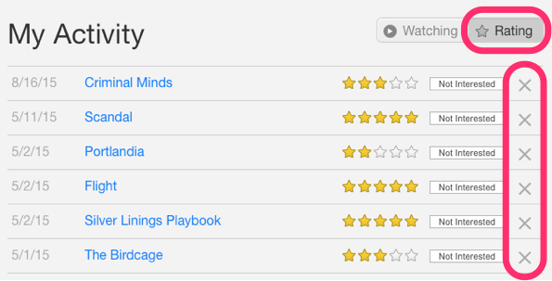
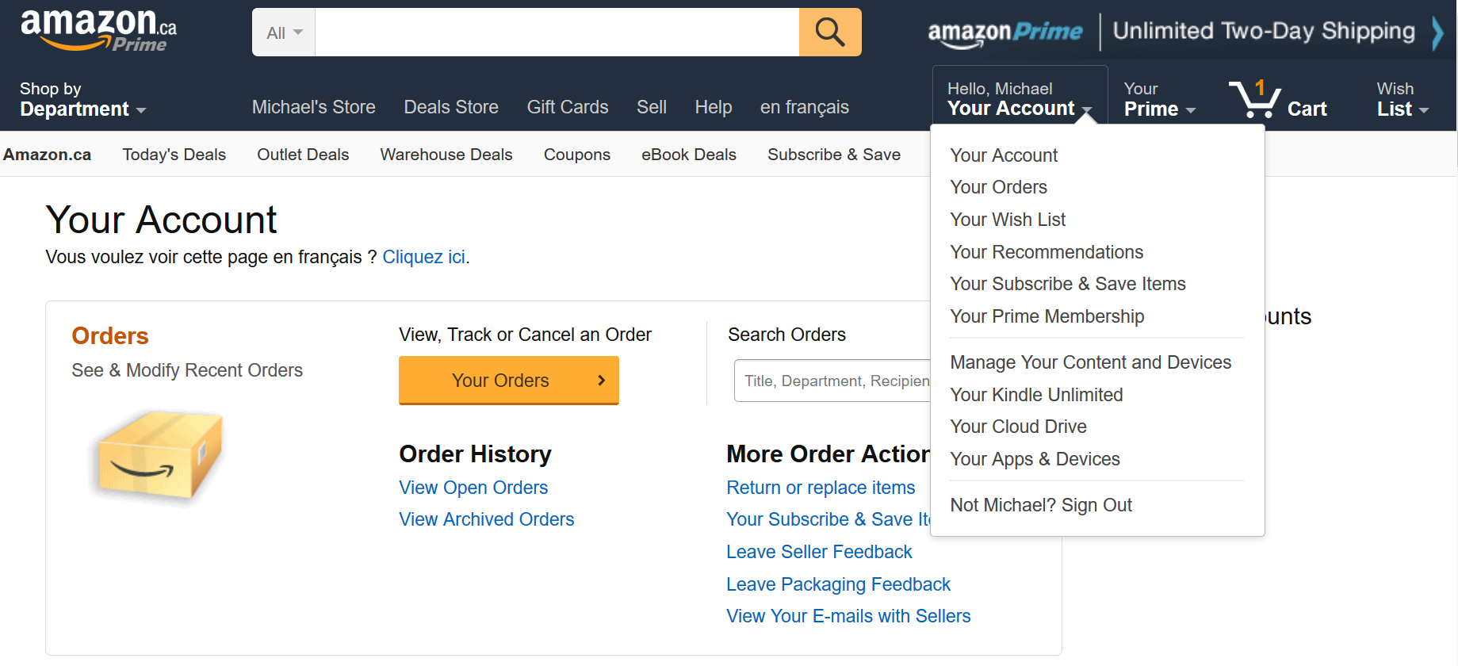
Data Collection
This is the first and most crucial step for building a recommendation engine. The data can be collected by two means: explicitly and implicitly. Explicit data is information that is provided intentionally, i.e. input from the users such as movie ratings. Implicit data is information that is not provided intentionally but gathered from available data streams like search history, clicks, order history, etc.
a. Netflix is collecting the data explicitly in the form of ratings given by user to different movies.
b. The order history of a user is recorded by Amazon which is an example of implicit mode of data collection.
© 2023 AiProff.ai

Slide 8
Data Storage
The amount of data dictates how good the recommendations of the model can get.
For example, in a movie recommendation system, the more ratings users give to movies, the better the recommendations get for other users.
The type of data plays an important role in deciding the type of storage that has to be used.
This type of storage could include a standard SQL database, a NoSQL database or some kind of object storage
© 2023 AiProff.ai

Slide 9
Filtering the data
After collecting and storing the data, we have to filter it so as to extract the relevant information required to make the final recommendations.
There are various algorithms that help us make the filtering process easier.
1. Content based filtering
2. Collaborative filtering
Let’s go through each algorithm in detail.
© 2023 AiProff.ai

Slide 10
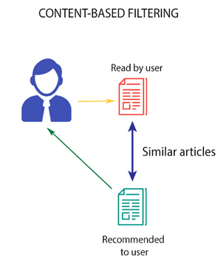
Content based filtering
This algorithm recommends products which are similar to the ones that a user has liked in the past.
For example, if a person has liked the movie “Inception”, then this algorithm will recommend movies that fall under the same genre. But how does the algorithm understand which genre to pick and recommend movies from?
Consider the example of Netflix. They save all the information
related to each user in a vector form. This vector contains the
past behavior of the user, i.e. the movies liked/disliked by the
user and the ratings given by them. This vector is known as
the profile vector. All the information related to movies is stored
in another vector called the item vector. Item vector contains the
details of each movie, like genre, cast, director, etc.
© 2023 AiProff.ai

Slide 11
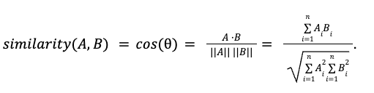
Content based filtering
The content-based filtering algorithm finds the cosine of the angle between the profile vector and item vector, i.e. cosine similarity.
For two vectors in two dimensions(i ,j) –
A=x1i+y1j
B=x2i+y2j
Dot product is defined as (x1*x2+y1*y2)
Magnitude is defined as |A|= sqrt(x1^2+y1^2)
|B|=sqrt(x2^2+y2^2)
Based on the cosine value, which ranges between -1 to 1, the movies are arranged in descending order and one of the two below approaches is used for recommendations:
Top-n approach: where the top n movies are recommended (Here n can be decided by the business)
Rating scale approach: Where a threshold is set and all the movies above that threshold are recommended
© 2023 AiProff.ai

Slide 12

Content based filtering
Other methods that can be used to calculate the similarity are:
Euclidean Distance: Similar items will lie in close proximity to each other if plotted in n-dimensional space. So, we can calculate the distance between items and based on that distance, recommend items to the user. The formula for the euclidean distance is given by:
Pearson’s Correlation: It tells us how much two items are correlated. Higher the correlation, more will be the similarity. Pearson’s correlation can be calculated using the following formula:
© 2023 AiProff.ai

Slide 13
Content based filtering
A major drawback of this algorithm is that it is limited to recommending items that are of the same type.
It will never recommend products which the user has not bought or liked in the past.
So if a user has watched or liked only action movies in the past, the system will recommend only action movies.
It’s scope is relatively narrow.
To improve on this type of system, we need an algorithm that can recommend items not just based on the content, but the behaviour of users as well.
Let’s open the code content_based_book_recommend.R
© 2023 AiProff.ai

Slide 14
Applications of Content-Based Filtering
Showcase diverse applications of content-based filtering in various industries:
E-commerce: Product recommendations based on user's browsing and purchase history.
Entertainment: Movie, TV show, and music recommendations based on past user preferences.
News Aggregators: Suggesting articles and news based on the user's reading history.
Use case studies or examples to make this slide more relatable and engaging.

Slide 15
Advantages and Challenges
Advantages:
Personalization: Tailors recommendations closely to each user's specific interests.
New Item Problem: Can recommend new items that haven't been rated yet.
Transparency: Easier to explain why items are recommended based on visible features.
Challenges:
Over-specialization: Tendency to recommend items too similar to what the user has already consumed.
Cold Start Problem: Difficulty in recommending for new users with limited interaction history.
Limited Diversity: May fail to introduce users to a broader variety of content.

Slide 16
Collaborative filtering
Let us understand this with an example.
If person A likes 3 movies, say Interstellar, Inception and Predestination, and person B likes Inception, Predestination and The Prestige, then they have almost similar interests.
We can say with some certainty that A should like The Prestige and B should like Interstellar.
The collaborative filtering algorithm uses “User Behavior” for recommending items.
This is one of the most commonly used algorithms in the industry as it is not dependent on any additional information.
There are primarily two types of collaborating filtering techniques as explained next.
© 2023 AiProff.ai

Slide 17
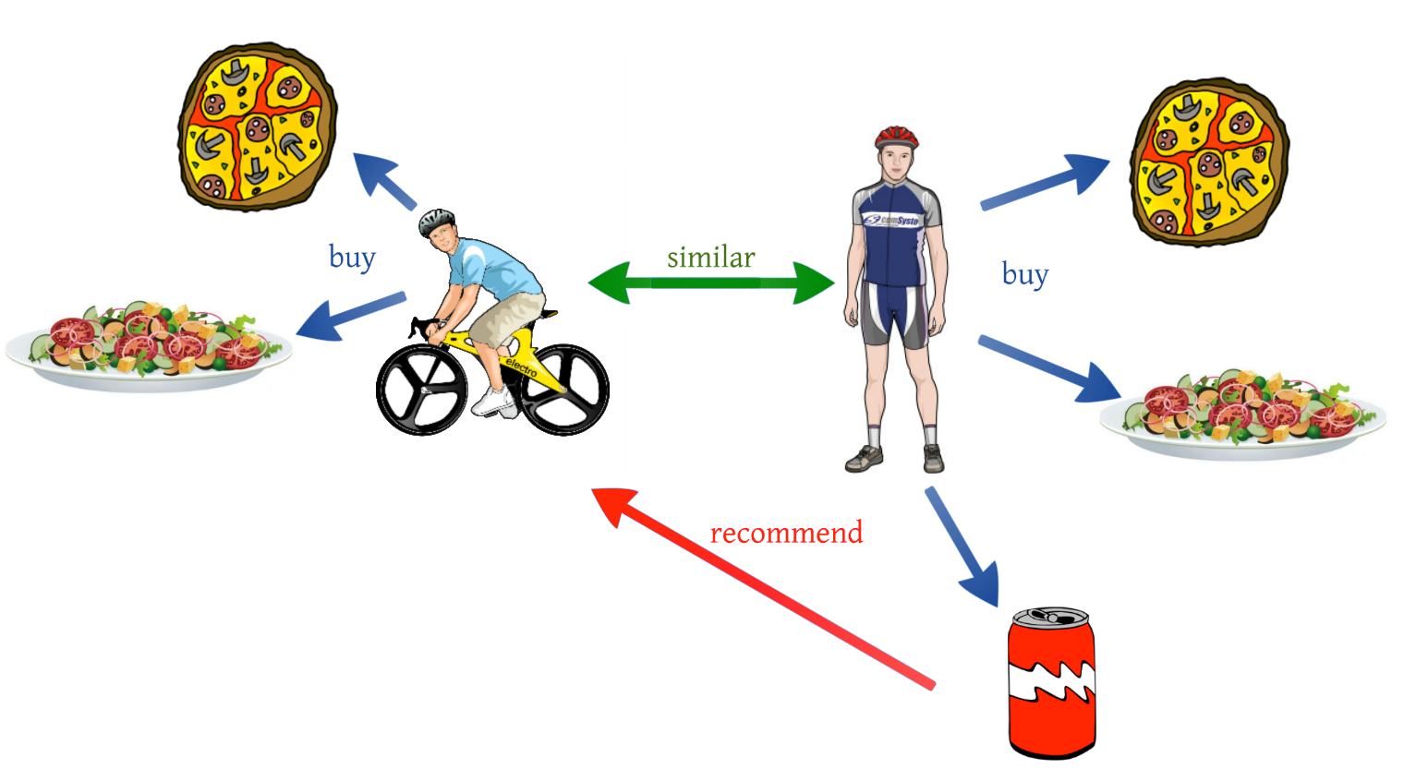

Collaborative filtering - User-User collaborative filtering
This algorithm first finds the similarity score between users. Based on this similarity score, it then picks out the most similar users and recommends products which these similar users have liked or bought previously.
In terms of our movies example from
earlier, this algorithm finds the similarity
between each user based on the ratings
they have previously given to different
movies. The prediction of an item for a
user u is calculated by computing the
weighted sum of the user ratings given
by other users to an item i.
The prediction Pu,i is given by:
Here,
P_{u,i} is the prediction of an item
R_{v,i} is the rating given by a user v to a movie i
S_{u,v} is the similarity between users
© 2023 AiProff.ai

Slide 18
Collaborative filtering - User-User collaborative filtering
Now, we have the ratings for users in profile vector and based on that we have to predict the ratings for other users. Following steps are followed to do so:
For predictions we need the similarity between the user u and v. We can make use of Pearson correlation.
First we find the items rated by both the users and based on the ratings, correlation between the users is calculated.
The predictions can be calculated using the similarity values. This algorithm, first of all calculates the similarity between each user and then based on each similarity calculates the predictions. Users having higher correlation will tend to be similar.
Based on these prediction values, recommendations are made. Let us understand it with an example:
© 2023 AiProff.ai

Slide 19

Collaborative filtering -
User-User collaborative filtering
Consider the user-movie rating matrix:
User/Movie x1 x2 x3 x4 x5 Mean User Rating
A 4 1 – 4 – 3
B – 4 – 2 3 3
C – 1 – 4 4 3
Here we have a user movie rating matrix. To understand this in a more practical manner, let’s find the similarity between users (A, C) and (B, C) in the above table. Common movies rated by A and C are movies x2 and x4 and by B and C are movies x2, x4 and x5
The correlation between user A and C is more than the correlation between B and C. Hence users A and C have more similarity and the movies liked by user A will be recommended to user C and vice versa
© 2023 AiProff.ai

Slide 20
Collaborative filtering - User-User collaborative filtering
This algorithm is quite time consuming as it involves calculating the similarity for each user and then calculating prediction for each similarity score. One way of handling this problem is to select only a few users (neighbors) instead of all to make predictions, i.e. instead of making predictions for all similarity values, we choose only few similarity values. There are various ways to select the neighbors:
* Select a threshold similarity and choose all the users above that value
* Randomly select the users
* Arrange the neighbors in descending order of their similarity value and choose top-N users
* Use clustering for choosing neighbors
This algorithm is useful when the number of users is less. Its not effective when there are a large number of users as it will take a lot of time to compute the similarity between all user pairs. This leads us to item-item collaborative filtering, which is effective when the number of users is more than the items being recommended.
© 2023 AiProff.ai

Slide 21


Collaborative filtering - Item-Item collaborative filtering
So in our case we will find the similarity between each movie pair and based on that, we will recommend similar movies which are liked by the users in the past. This algorithm works similar to user-user collaborative filtering with just a little change – instead of taking the weighted sum of ratings of “user-neighbors”, we take the weighted sum of ratings of “item-neighbors”. The prediction is given by:
Now we will find the similarity between items
© 2023 AiProff.ai

Slide 22
Collaborative filtering -Item-Item collaborative filtering
Now, as we have the similarity between each movie and the ratings, predictions are made and based on those predictions, similar movies are recommended. Let us understand it with an example
User/Movie x1 x2 x3 x4 x5
A 4 1 2 4 4
B 2 4 4 2 1
C – 1 – 3 4
Mean Item Rating 3 2 3 3 3
Here the mean item rating is the average of all the ratings given to a particular item (compare it with the table we saw in user-user filtering). Instead of finding the user-user similarity as we saw earlier, we find the item-item similarity.
To do this, first we need to find such users who have rated those items and based on the ratings, similarity between the items is calculated. Let us find the similarity between movies (x1, x4) and (x1, x5).
Common users who have rated movies x1 and x4 are A and B while the users who have rated movies x1 and x5 are also A and B.
© 2023 AiProff.ai

Slide 23

Collaborative filtering - Item-Item collaborative filtering
The similarity between movie x1 and x4 is more than the similarity between movie x1 and x5.
So based on these similarity values, if any user searches for movie x1, they will be recommended movie x4 and vice versa.
Let’s open the code Movie Recommendation System in R.R
© 2023 AiProff.ai

Slide 24
Collaborative filtering - Item-Item collaborative filtering
But a key challenge comes up when a completely new user need to be recommended to ?
This is called a Cold Start Problem .
There can be two types of cold start:
1. Visitor Cold Start
2. Product Cold Start
© 2023 AiProff.ai

Slide 25
Collaborative filtering – Cold Start Challenge
Visitor Cold Start means that a new user is introduced in the dataset.
Since there is no history of that user, the system does not know the preferences of that user. It becomes harder to recommend products to that user. So, how can we solve this problem?
One basic approach could be to apply a popularity based strategy, i.e. recommend the most popular products.
These can be determined by what has been popular recently overall or regionally. Once we know the preferences of the user, recommending products will be easier.
Product Cold Start means that a new product is launched in the market or added to the system.
User action is most important to determine the value of any product.
More the interaction a product receives, the easier it is for our model to recommend that product to the right user. We can make use of Content based filtering to solve this problem.
The system first uses the content of the new product for recommendations and then eventually the user actions on that product.
© 2023 AiProff.ai

Slide 26
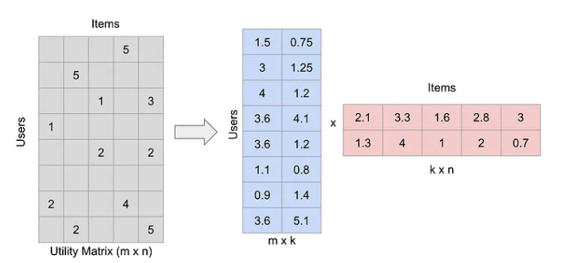
Matrix Factorization – Applying Linear Algebra to Recommendation Systems
Matrix Factorization is a technique used in recommendation systems to predict missing ratings in a user-item matrix.
This matrix, known as the utility matrix, contains ratings for each user-item pair.
Since most of these ratings are unknown initially, the matrix is typically sparse.
Matrix Factorization breaks down this large matrix into smaller ones, making it easier to predict and fill in the missing ratings.
Linear Algebra to the rescue !
© 2023 AiProff.ai

Slide 27
Understanding Rating Matrix
Ratings Matrix
Structure of the ratings matrix –
User * item matrix
Typically users x items, filled with ratings and many missing values (indicating unrated items).
Please open the code user_rating.R

Slide 28
Understanding Rating Matrix
Breaking Down the Matrix
How matrix factorization works -
Break the original matrix into two lower-dimensional matrices (user-latent factors and item-latent factors).
The goal is to approximate the original matrix by multiplying these two matrices.
Input: User-item interaction matrix (e.g., rating matrix)
Output: Two lower-rank matrices:
User matrix (U): Captures user preferences across latent factors
Item matrix (V): Encodes item attributes based on latent factors
Optimization: Algorithms minimize error between original and reconstructed matrix

Slide 29
Understanding Rating Matrix
MF represents the user-item interaction matrix A as the product of two lower-rank matrices
U and V:
A ≈ U * V
U has each row representing a user's preference vector across d latent factors,
V has each row representing an item's feature vector in the same d-dimensional space.
By minimizing the difference between the original matrix A and the reconstructed matrix (U * V), we reveal the latent factors that explain the interactions.

Slide 30
Understanding Rating Matrix
Rank of a matrix –
The rank of a matrix is the maximum number of linearly independent column vectors in the matrix.
Equivalently, it can also be defined as the maximum number of linearly independent row vectors in the matrix.
Both definitions will give the same number for the rank.
It is a useful number in Machine Learning and gives insights on a lot of aspects in Linear Regression , Recommendation System and others

Slide 31
Select a Matrix Factorization algorithm
Objective: Consider data sparsity, noise level, and interpretability
Popular algorithms:
Singular value decomposition (SVD)
Alternating Least Squares
Gradient descent-based: SGD, Adam
Probabilistic: Bayesian MF, NMF
Factors to consider: Computational efficiency, scalability, and domain-specific requirements

Slide 32
Alternating Least Squares
The Alternating Least Squares (ALS) technique for matrix factorization is a method used mainly in recommendation systems, like those on streaming services or e-commerce websites, to predict what users might like based on their past behavior.
Imagine we have a big table (matrix) where each row represents a user, and each column represents an item (like a movie, product, etc.).
The values in the table indicate how much a user likes an item, which could be whether they watched a movie, how they rated it, or if they purchased a product.
However, in reality, most of this table is empty because not every user interacts with every item.

Slide 33
Alternating Least Squares
The goal of ALS is to fill in these empty spots with predictions (guesses) about how much a user might like an item they haven't interacted with yet.
To do this, ALS breaks down (factorizes) the big table into two smaller tables (matrices) in a way that when these smaller tables are multiplied, they recreate the original table as closely as possible, including good guesses for all those empty spots.
The "Alternating" part in ALS comes from how it achieves this.
It starts by taking a guess to fill one of the smaller tables.
Then, keeping this table fixed, it adjusts the other small table to get as close as possible to the original big table.
Next, it switches: it keeps the newly adjusted table fixed and tweaks the first one to get even closer. It keeps alternating back and forth, adjusting one table at a time, which makes the process manageable and efficient.

Slide 34
Alternating Least Squares
ALS tries to understand the preferences of a group of friends about different cuisines by observing a few of their dining choices.
It starts with guesses about each person's preferences and the characteristics of each cuisine.
Then, it refine those guesses about the cuisines based on what it knows about the friends' preferences(user-item matrix) , and next, it update its understanding of each friend's preferences based on the refined guesses about the cuisines.
It goes back and forth in this way until the guesses are consistent with the dining choices which are observed, helping it make educated guesses about what cuisines they might enjoy in the future.

Slide 35
Singular Value Decomposition
Understanding Singular Value Decomposition (SVD)
SVD as a fundamental technique in linear algebra used to decompose a matrix into three distinct matrices: U (left singular vectors), Σ (singular values), and V^T (right singular vectors).
In recommendation systems when all ratings for a user/product are not available then it helps to derive
Matrix A is decomposed into U, Σ, and V^{T}
A=UΣV^{T}
Where
U captures key features of the rows of A
Σ ranks these features by importance (singular values)
V^{T} captures key features of the columns of A

Slide 36
Singular Value Decomposition
Mathematically, in the equation A = UΣV^{T}
A is the original matrix
U is a matrix of left singular vectors
Σ is a diagonal matrix with singular values and
V^{T} is the transpose of the matrix of right singular vectors
U and V (orthogonal matrices) and Σ (non-negative diagonal elements)

Slide 37
Singular Value Decomposition
Mathematically, in the equation A = UΣV^{T}
If we say that A has a dimension of m*n
U is a matrix of left singular vectors (having dimension as m*n). A singular vector -
For a matrix A is a non-zero vector v such that Av = λv for some scalar λ, called the singular value
Represents a direction in which the matrix A stretches or shrinks data points
Can be multiple for a matrix, depending on its size and properties
Is associated with a specific singular value, reflecting the magnitude of the stretching/shrinking in that direction

Slide 38
Singular Value Decomposition
Mathematically, in the equation A = UΣV^{T}
Σ is Diagonal Matrix with Singular Values which -
Holds the singular values extracted from the original matrix A during SVD
Each singular value represents the "magnitude" of a particular latent factor captured by SVD
The larger the singular value, the more significant the corresponding latent factor in explaining the structure of A

Slide 39
Singular Value Decomposition
Mathematically, in the equation A = UΣV^{T}
V^{T} is -
The transpose of another orthogonal matrix, V, of dimensions n x p (where p is the rank of A)
Please open the code SVD.R and SVD_Recommend.R

Slide 40
Singular Value Decomposition
When SVD is applied to a matrix with imputed missing values, it refines the imputed values by aligning them with the latent structure uncovered in the decomposition process.
This results in predictions for missing ratings that are potentially more accurate and reflective of the underlying data dynamics than the initial imputations.

